Slide 1
Programming in C
By
MS KRITI KAUSIK
kriti29kausik@gmail.com

Slide 2
Dynamic Data structures - Pointers
Unit IV
Chapter I

Slide 3
Contents
Introduction to
Pointers
Declaration and Initialization
Pointer Expression
Arithmetic, Comparison
Malloc vs. Calloc
Arrays of Pointers
Pointers to Pointers
Pointers to Functions
Function Returning Pointers
Introduction to
Structures
Basics, Referencing Elements
Arrays of Structures
Passing Structures to Functions
Structure Pointers
Structures with in Structures
Unions
Declarations, Uses
Enumerated Data types
typedef

Slide 4
Pointers
Declaration and Initialization
The pointer in C language is a variable which stores the address of another variable. This variable can be of type int, char, array, function, or any other pointer.
Syntax
Datatype *varname;
int *ptr;
Example
int n = 10;
int* p = &n;
Here, * refers the indication of pointer variable
& refers to the address of the particular variable
int *ip; /* pointer to an integer */
double *dp; /* pointer to a double */
float *fp; /* pointer to a float */
char *ch /* pointer to a character */

Slide 5
Example for Pointers
#include<stdio.h>
#inlcude<conio.h>
void main()
{
int number=50;
int *p;
p=&number;
printf("Address of p variable is %x \n", p);
printf("Value of p variable is %d \n",*p);
}
Address of p variable is fff4
Value of p variable is 50
p contains the address of the number therefore printing p gives the address of number.

Slide 6
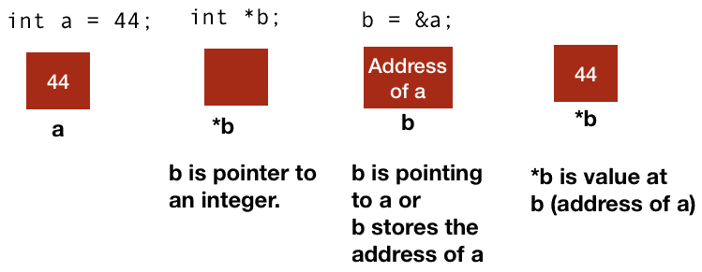
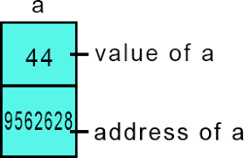
The * and & Operator
& means the address-of, you will see that in placeholders for functions to modify the parameter variable as in C, parameter variables are passed by value, using the ampersand means to pass by reference.
* means the dereference of a pointer variable, meaning to get the value of that pointer variable

Slide 7
Example for Without Pointers
#include <stdio.h>
int main ()
{
int var1;
char var2[10];
printf("Address of var1 variable: %x\n", &var1 );
printf("Address of var2 variable: %x\n", &var2 );
return 0;
}
Output
Address of var1 variable: bff5a400
Address of var2 variable: bff5a3f6

Slide 8
Null Pointers Example
#include <stdio.h>
int main ()
{
int *ptr = NULL;
printf("The value of ptr is : %x\n", ptr );
return 0;
}
The value of ptr is 0

Slide 9
Pointer Examples
#include <stdio.h>
int main ()
{
int var;
int *ptr;
var = 30;
ptr = &var;
printf("Value of var = %d\n", var );
printf("Value available at the Address = %x\n", ptr );
printf("Value = %d\n", **ptr);
return 0;
}
Output
Value of var = 30
Value available at the Address = 3EDB2A44
Value of var = 30

Slide 10
Pointer Example for Swapping numbers
#include <stdio.h>
void swap(int *a, int *b)
{
int t;
t = *a;
*a = *b;
*b = t;
}
int main()
{
int num1,num2;
printf("Enter value of num1: ");
scanf("%d",&num1);
printf("Enter value of num2: ");
scanf("%d",&num2);
printf("Before Swapping: num1=%d, num2=%d\n",num1,num2);
swap(&num1,&num2);
printf("After Swapping: num1=%d, num2=%d\n",num1,num2);
return 0;
}
Output
Enter value of num1: 100
Enter value of num2: 200
Before Swapping: num1=100, num2=200
After Swapping: num1=200, num2=100

Slide 11
Pointer Example for Swapping numbers
#include<stdio.h>
void area_peri(float, float*, float*);
int main()
{
float radius, area, perimeter;
printf("Enter radius of Circle\n");
scanf("%f", &radius);
area_peri(radius, &area, &perimeter);
printf("\nArea of Circle = %0.2f\n", area);
printf("Perimeter of Circle = %0.2f\n", perimeter);
return 0;
}
void area_peri(float r, float *a, float *p)
{
*a = 3.14 * r * r;
*p = 2 * 3.14 * r;
}
Output
Enter radius of Circle: 9.8
Area of Circle = 301.57
Perimeter of Circle = 61.54

Slide 12
Arithmetic Pointer Examples
A pointer in c is an address, which is a numeric value.
Therefore, user can perform arithmetic operations on a pointer just as user can on a numeric value. There are four arithmetic operators that can be used on pointers:
1. Pointer Increment ++
2. Pointer Decrement --
3. Pointer Addition +
4. Pointer Subtraction –

Slide 13
Pointer Increment (++) Expression
#include <stdio.h>
const int MAX = 3;
int main ()
{
int var[] = {10, 100, 200};
int i, *ptr;
ptr = var;
for ( i = 0; i < MAX; i++)
{
printf("Address of var[%d] = %x\n", i, ptr );
printf("Value of var[%d] = %d\n", i, *ptr );
ptr++;
}
return 0;
}
Output
Address of var[0] = bf882b30
Value of var[0] = 10
Address of var[1] = bf882b34
Value of var[1] = 100
Address of var[2] = bf882b38
Value of var[2] = 200

Slide 14
Pointer Decrement (--) Expression
#include <stdio.h>
const int MAX = 3;
int main ()
{
int var[] = {10, 100, 200};
int i, *ptr;
/* let us have array address in pointer */
ptr = &var[MAX-1];
for ( i = MAX; i > 0; i--)
{
printf("Address of var[%d] = %x\n", i-1, ptr );
printf("Value of var[%d] = %d\n", i-1, *ptr );
/* move to the previous location */
ptr--;
}
return 0;
}
Output
Address of var[2] = bfedbcd8
Value of var[2] = 200
Address of var[1] = bfedbcd4
Value of var[1] = 100
Address of var[0] = bfedbcd0
Value of var[0] = 10

Slide 15
Pointer Addition (+) Expression
new_address= current_address + (number * size_of(data type))
32-bit int variable - it will add 2 * number
64-bit int variable - it will add 4 * number
Example
#include<stdio.h>
int main()
{
int number=50;
int *p;
p=&number;
printf("Address of p variable is %u \n",p);
p=p+3;
printf("After adding 3: Address of p variable is %u \n",p);
return 0;
}
Output
Address of p variable is 3214864300
After adding 3: Address of p variable is 3214864312

Slide 16
Pointer Subtraction (-) Expression
new_address= current_address - (number * size_of(data type))
32-bit int variable - it will subtract 2 * number
64-bit int variable - it will subtract 4 * number
Example
#include<stdio.h>
int main()
{
int number=50;
int *p;
p=&number;
printf("Address of p variable is %u \n",p);
p=p-3;
printf("After subtracting 3: Address of p variable is %u \n",p);
return 0;
}
Output
Address of p variable is 3214864300
After subtracting 3: Address of p variable is 3214864288

Slide 17
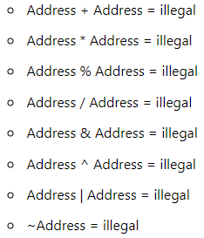
Illegal Arithmetic with Pointers
There are various operations which can not be performed on pointers. Since, pointer stores address hence users must ignore the operations which may lead to an illegal address, for example, addition, and multiplication. A list of such operations is given below

Slide 18
Comparison
Pointer values can be compared with one another.
Example an Integer based comparison is done.
Output
#include <stdio.h>
int main()
{
int a,b;
int *pa,*pb;
pa=&a; pb=&b;
printf("Enter first integer: ");
scanf("%d",pa);
printf("Enter second integer: ");
scanf("%d",pb);
if(*pa==*pb)
printf("Integers are equal.\n");
else
printf("Integers are not equal.\n");
return 0;
}
Enter first integer: 100
Enter second integer: 100
Integers are equal

Slide 19
Dynamic Memory Allocation
The process of allocating memory at runtime is known as dynamic memory allocation
Dynamic Memory Allocation is manual allocation and freeing of memory according to user programming needs
Dynamic memory allocation in c language is possible by 4 functions of stdlib.h header file.
malloc() allocates single block of requested memory.
calloc() allocates multiple block of requested memory.
realloc() reallocates the memory occupied by malloc() or calloc() functions.
free() frees the dynamically allocated memory.

Slide 20

malloc()
“malloc” or “memory allocation” method in C is used to dynamically allocate a single large block of memory with the specified size.
It returns a pointer of type void which can be cast into a pointer of any form.
It initializes each block with default garbage value
malloc() allocates single block of requested memory.
Syntax
ptr=(cast-type*) malloc (byte-size)
Example
ptr = (int*) malloc(100 * sizeof(int));
Since the size of int is 4 bytes, this statement will allocate 400 bytes of memory.
And, the pointer ptr holds the address of the first byte in the allocated memory.

Slide 21
malloc() Example
#include <stdio.h>
#include <stdlib.h>
int main ()
{
int *pt;
pt = malloc (sizeof(int));
if (pt != NULL)
{
printf (" Memory is created using the malloc() function ");
}
else
printf (" memory is not created ");
return 0;
}
Output
Memory is created using the malloc() function

Slide 22
calloc()
The name "calloc" stands for contiguous allocation.
The calloc function requires two arguments instead of one as used by malloc(). Otherwise, it operates in the same way as malloc().
When calloc is declared for the sake of allocating a block of memory, the assigned region is immediately initialized to zero.
It returns NULL if memory is not sufficient.
Syntax
ptr=(data-type*)calloc(number, byte-size)
Example 1:
ptr = (float*) calloc(25, sizeof(float));
Example 2:
int*ptr;
ptr = (int*) calloc(10,2); (Total 20 bytes)
here, 10 signifies the total number of elements that require memory allocation

Slide 23
malloc() vs. calloc()
malloc() | calloc()
Malloc() function will create a single block of memory of size specified by the user. | Calloc() function can assign multiple blocks of memory for a variable.
Malloc function contains garbage value. | The memory block allocated by a calloc function is always initialized to zero.
Number of argument is 1. | Number of arguments are 2.
Calloc is slower than malloc. | Malloc is faster than calloc.
It is not secure as compare to calloc. | It is secure to use compared to malloc.
Time efficiency is higher than calloc(). | Time efficiency is lower than malloc().
Malloc() function returns only starting address and does not make it zero. | Before allocating the address, Calloc() function returns the starting address and make it zero.
It does not perform initialization of memory. | It performs memory initialization.

Slide 24
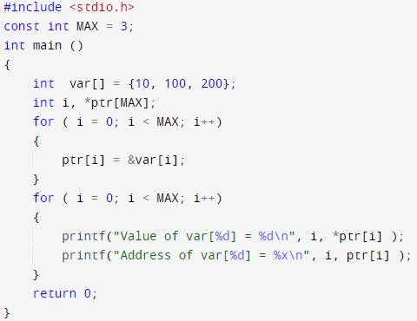
Arrays of Pointers
An array can be used with pointers to do some operations
Elements address store in consecutive locations
Output
Value of var[0] = 10
Address of var[0] = D27EE67C
Value of var[1] = 100
Address of var[1] = D27EE680
Value of var[2] = 200
Address of var[2] = D27EE684

Slide 25
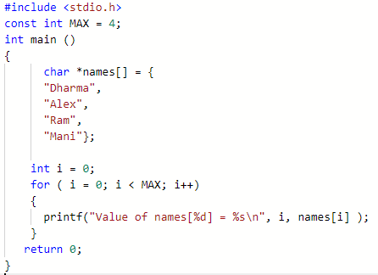
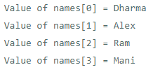
Arrays of Pointers Example with name
Output

Slide 26
Pointers to Pointers
Double pointers – Adding pointers with pointers
1) Referencing - Assigning an address to the pointer
2) Dereferencing - Accessing the value stored at the pointer
Output
Address of a = 5c653f4
ptr is pointing to the address = 5c653f4
dptr is pointing to the address = 5c653e8
Value of a = 10
*ptr = 10
**dptr = 10
#include<stdio.h>
int main()
{
int a = 10;
int *ptr = &a; //ptr references a
int **dptr = &ptr; //dptr references ptr
printf("Address of a = %p\n",&a);
printf("ptr is pointing to the address = %p\n",ptr);
printf("dptr is pointing to the address = %p\n",dptr);
printf("Value of a = %d\n",a);
printf("*ptr = %d\n",*ptr);
printf("**dptr = %d\n",**dptr);
return 0;
}

Slide 27
Pointers with Functions
Pointers can be used with functions to do some tasks
The code of a function always resides in memory, which means that the function has some address. Users can get the address of memory by using the function pointer
Output
Address of main() Function is : 2951
#include <stdio.h>
void main()
{
printf("Address of main() Function is: %p", main);
}
Declaration of a function pointer
datatype (*ptr_name) (type1, type2…);
Example
int (*ip) (int);
In this declaration, *ip is a pointer that points to a function which returns an int value and accepts an integer value as an argument.

Slide 28
Pointers with Functions
Example
float (*fp) (int , int); // Declaration of a function pointer
float func( int , int ); // Declaration of function
fp = func; // Assigning address of func to the fp pointer
#include <stdio.h>
int add(int,int);
int main()
{
int a,b;
int (*ip)(int,int);
int result;
printf("Enter the values of a and b : ");
scanf("%d %d",&a,&b);
ip=add;
result=(*ip)(a,b);
printf("Value after addition is : %d",result);
return 0;
}
int add(int a,int b)
{
int c=a+b;
return c;
}
Output
Enter the values of a and b: 4
55
Value after addition is : 59

Slide 29
Function returning Pointers
C language allows the users to return a pointer from a function.
To do so, user has to declare a function returning a pointer
Syntax
datatype * function name(list of arguments)
{
set of statements;
}
Example
int * myFunction()
{
set of statements;
}

Slide 30
Function returning Pointers
#include <stdio.h>
int* findLarger(int*, int*);
void main()
{
int a=0;
int b=0;
int *result;
printf(" Input the first number : ");
scanf("%d", &a);
printf(" Input the second number : ");
scanf("%d", &b);
result=findLarger(&a, &b);
printf(" The number %d is larger ",*result);
}
int* findLarger(int *n1, int *n2)
{
if(*n1 > *n2)
return n1;
else
return n2;
}
Output
Input the first number : 5
Input the second number : 6
The number 6 is larger

Slide 31
Advantages of Pointers
Pointer reduces the code and improves the performance, it is used to retrieving strings, trees, etc. It can also be used with arrays, structures, and functions.
Users can return multiple values from a function using the pointer.
It makes user able to access any memory location in the computer's memory.
CHAPTER-2

Slide 32
Structures
Structure in c is a user-defined data type that enables us to store the collection of different data types.
Each element of a structure is called a member
Structures are used to represent a record. Suppose user wants to keep track of the books in a library.
Example
Title
Author
Subject
Book ID
Syntax
struct structure_name
{
data_type member1;
data_type member2;
.
.
data_type memeberN;
};

Slide 33
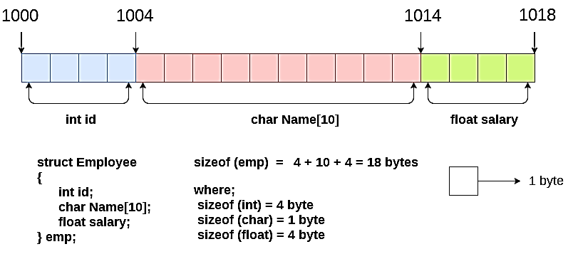
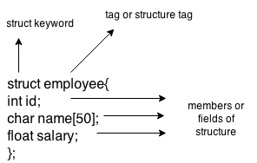
Structures
Example
struct employee
{ int id;
char name[20];
float salary;
};

Slide 34
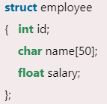
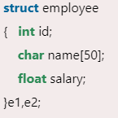
Structures
Declaring structure variable
Users can declare a variable for the structure so that user can access the member of the structure easily.
There are two ways to declare structure variable:
By struct keyword within main() function
By declaring a variable at the time of defining the structure
1. It should be declared within the main function.
2. Outside main function
struct employee e1, e2;
The variables e1 and e2 can be used to access the values stored in the structure

Slide 35
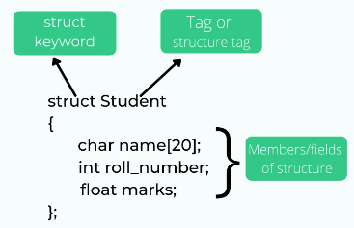
Accessing Members
Declaring structure variable
There are two ways to access structure members:
By . (member or dot operator)
By -> (structure pointer operator)
For the previous code to access the ID member of p1 variable by. (member) operator.

Slide 36
Accessing Members Type 1 - Example
#include<stdio.h>
#include <string.h>
struct employee
{ int id;
char name[50];
}e1;
void main( )
{
e1.id=101;
strcpy(e1.name, “Alex");
printf( "employee 1 id : %d\n", e1.id);
printf( "employee 1 name : %s\n", e1.name);
}
Output
employee 1 id : 101
employee 1 name : Alex

Slide 37
Accessing Members Type 2- Example
#include <stdio.h>
void main()
{
struct item
{
int id;
const char *company;
float cost;
};
struct item radio = {101, "Sony", 99.99};
struct item oven;
printf("radio details: \n");
printf("id = %d\n", radio.id);
printf("company = %s\n", radio.company);
printf("price = %.2f\n", radio.cost);
oven.id = 102;
oven.company = "Panasonic"; // assiging value using '.' operator
printf("oven company: %s\n", oven.company);
}
Output
radio details:
id = 101
company = Sony
price = 99.99
oven company: Panasonic

Slide 38
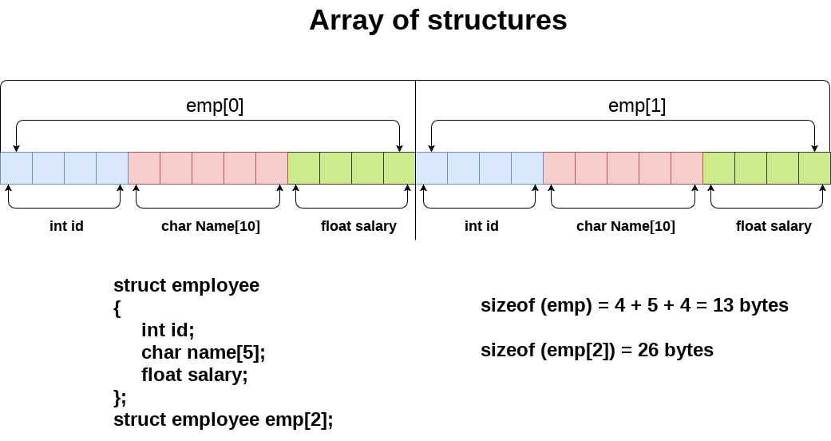
Array of Structures
An array of structures in C can be defined as the collection of multiple structures variables where each variable contains information about different entities.
The array of structures in C are used to store information about multiple entities of different data types. The array of structures is also known as the collection of structures.

Slide 39
Array of Structures Example
#include<stdio.h>
#include <string.h>
struct student
{
int rollno;
char name[10];
};
int main()
{
int i;
struct student st[5];
printf("Enter Records of 5 students");
for(i=0;i<5;i++){
printf("\nEnter Rollno:");
scanf("%d",&st[i].rollno);
printf("\nEnter Name:");
scanf("%s",&st[i].name);
}
printf("\nStudent Information List:");
for(i=0;i<5;i++){
printf("\nRollno:%d, Name:%s",st[i].rollno,st[i].name);
}
}
Enter Records of 4 students
Enter Rollno:1
Enter Name:Dharma
Enter Rollno:2
Enter Name:Alex
Enter Rollno:3
Enter Name:Ram
Enter Rollno:4
Enter Name:Mani
Student Information List:
Rollno:1, Name:Dharma
Rollno:2, Name:Alex
Rollno:3, Name:Ram
Rollno:4, Name:Mani

Slide 40
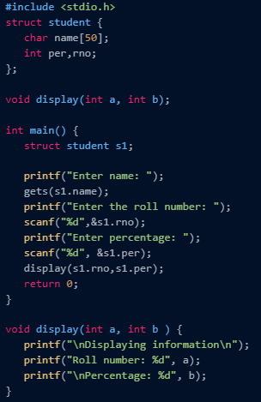
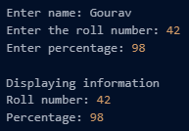
Passing Structures to Functions
Users can use the dot (.) operator to access the individual members of the structure and pass them to the function

Slide 41
Structure Pointers
Pointer to structure holds the add of the entire structure
It is used to create complex data structures such as linked lists, trees, graphs and so on
The members of the structure can be accessed using a special operator called as an arrow operator ( -> )
Declaration
Here, it is the declaration for pointers to structures in C programming −
struct tagname *ptr; For example: struct student *s
Accessing
It is explained here, how to access the pointers to structures.
Ptr-> membername;
For example: s->sno, s->sname, s->marks;

Slide 42
Structure Pointers Example
#include<stdio.h>
struct student
{
int sno;
char sname[30];
float marks;
};
void main ( )
{
struct student s;
struct student *st;
printf("enter sno, sname, marks:");
scanf ("%d%s%f", & s.sno, s.sname, &s. marks);
st = &s;
printf ("details of the student are");
printf ("Number = %d", st ->sno);
printf ("name = %s", st->sname);
printf ("marks =%f", st ->marks);
}
Output
enter sno, sname, marks:1 Lucky 98
details of the student are:
Number = 1
name = Lucky
marks =98.000000

Slide 43
Nested Structures
Structures within Structures
Nested structures means, that one structure has another structure as member variable
C provides users the feature of nesting one structure within another structure by using which, complex data types are created
Syntax
Example
struct Student
{
char[30] name;
int age;
struct Address
{
char[50] locality;
char[50] city;
int pincode;
}addr;
};
struct StructOuter
{
structure member;
….
struct StructInner
{
structure member;
….
};
};
struct Student Sample;

Slide 44
Nested Structures Example
#include <stdio.h>
#include <string.h>
struct Employee
{
int id;
char name[20];
struct Date
{
int dd;
int mm;
int yyyy;
}doj;
}e1;
int main( )
{
e1.id=101;
strcpy(e1.name, “Mani");
e1.doj.dd=10;
e1.doj.mm=11;
e1.doj.yyyy=2014;
printf( "employee id : %d\n", e1.id);
printf( "employee name : %s\n", e1.name);
printf( "employee date of joining (dd/mm/yyyy) : %d/%d/%d\n", e1.doj.dd, e1.doj.mm,
e1.doj.yyyy);
return 0;
}
Output
employee id : 101
employee name : Mani
employee date of joining (dd/mm/yyyy) : 10/11/2014

Slide 45
Unions
A union is a special data type available in C that allows to store different data types in the same memory location.
Users can define a union with many members, but only one member can contain a value at any given time.
Unions provide an efficient way of using the same memory location for multiple-purpose
Syntax
Union unionName
{
datatype member1;
datatype member2;
……
datatype member1;
}
Example
union Data
{
int i;
float f;
char str[20];
} data;

Slide 46
Unions - Example
#include <stdio.h>
#include <string.h>
union Data
{
int i;
float f;
char str[20];
};
void main( )
{
union Data data;
printf( "Memory size occupied by data : %d\n", sizeof(data));
}
Output
Memory size occupied by data : 20

Slide 47
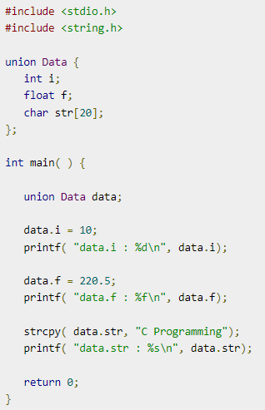

Unions - Example
Output

Slide 48
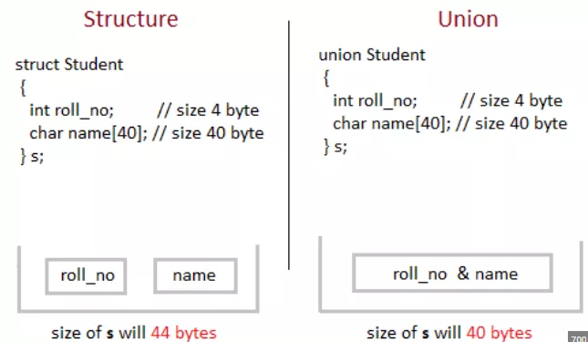
Structure vs. Union

Slide 49
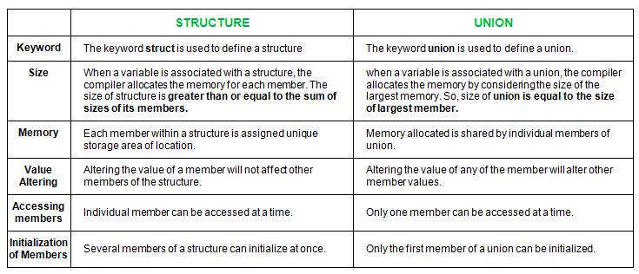
Structure vs. Union

Slide 50
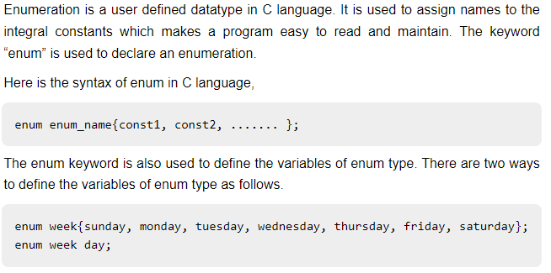
Enumerated Data Type
The enum is used when we want our variable to have only a set of values
The values assigned to the enum names must be integral constant, i.e., it should not be of other types such string, float, etc
enum names starting from 0, if users did not set values for indexing

Slide 51
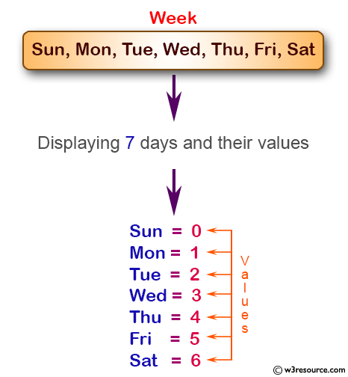
Enumerated Data Type - Example
#include <stdio.h>
void main()
{
enum week{Sun, Mon, Tue, Wed, Thu, Fri, Sat};
printf("Sun = %d", Sun);
printf("\nMon = %d", Mon);
printf("\nTue = %d", Tue);
printf("\nWed = %d", Wed);
printf("\nThu = %d", Thu);
printf("\nFri = %d", Fri);
printf("\nSat = %d", Sat);
}
Output
Sun = 0
Mon = 1
Tue = 2
Wed = 3
Thu = 4
Fri = 5
Sat = 6

Slide 52
Enumerated Data Type - Example
#include <stdio.h>
enum months {jan=1, feb, march, april, may, june, july, august, september, october, november, december};
void main()
{
for (int i=jan; i<=december; i++)
{
printf("%d, ",i);
}
}
Output
1 2 3 4 5 6 7 8 9 10 11 12

Slide 53
Typedef
The typedef is a keyword used in C programming to provide some meaningful names to the already existing variable in the C program.
It equals the alias for the commands.
I is used to redefine the name of an already existing variable.
Syntax
typedef <existing_name> <alias_name>
Here, 'existing_name' is the name of an already existing variable while 'alias name' is another name given to the existing variable
Example
typedef int hai;
hai i;

Slide 54
Typedef Example
#include <stdio.h>
void main()
{
typedef int Fish;
Fish i, j;
i=10;
j=20;
printf(“\n Value of i is :%d", i);
printf("\n Value of j is :%d", j);
}
#include<stdio.h>
void main()
{
typedef int num;
typedef num over_num;
over_num a;
printf("Enter a number: ");
scanf("%d", &a);
printf("You entered %d", a);
}
Output
Enter a number :10
You entered : 10
Output
Value of i is :10
Value of j is :20

Slide 55
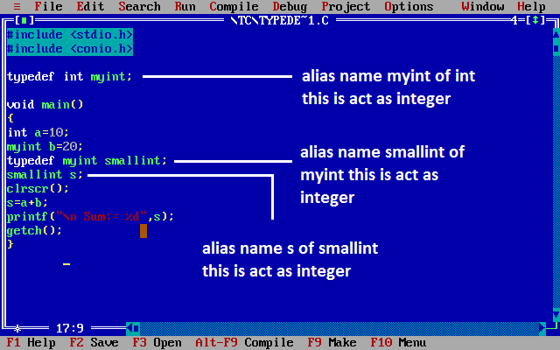
Typedef

Slide 56
Credits
https://www.tutorialspoint.com/cprogramming/c_pointers.htm
https://www.javatpoint.com/malloc-in-c
https://www.guru99.com/difference-between-malloc-and-calloc.html
https://www.log2base2.com/C/pointer/pointer-to-pointer-in-c.html

Slide 57
Roadmap for Unit IV
Introduction to Pointers
Structures
Enum and Typedef
1
3
5
2
4
6
Pointer Expressions and Arithmetic
Union
Summary

Slide 58

Roadmap to Programming in C
Unit I
Computer Based Problem Solvingand Overview of C
Unit III
Functions and Recursions
Unit V
File Handling, Preprocessor, Standard Library and Header Files
1
3
5
2
4
6
Unit – II
Branching, Looping, Arrays, Strings
Unit IV
Dynamic Data Structures, Pointers, Union
Revision

Slide 59
Feedback – Rating Star
Communication, Presentation, Examples and Exercises
$90
Communication, Presentation, Exercises
$80
Communication, Presentation, Exercises
$60
Communication, Presentation, Example
$50
Communication, Presentation
$40
Communication only
$30

Slide 60
Thanks!
Any questions?
You can find me at:
Kriti29kausik@gmail.com

